Slide 1


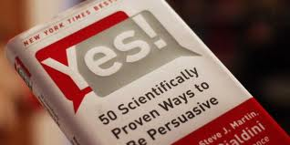
THE ART AND SCIENCE OF PERSUASION AND PERSUASION PRINCIPLES
Yes! 50 Scientifically Proven Ways to Be Persuasive – Robert B. Cialdini

Slide 2
PERSUASION PRINCIPLES
The first principle is that people are more likely to follow someone who is similar to them than someone who is not. Wise managers, then, enlist peers to help make their cases.
Second, people are more willing to cooperate with those who are not only like them but who like them, as well. So it’s worth the time to uncover real similarities and offer genuine praise.
Third, experiments confirm the intuitive truth that people tend to treat you the way you treat them. It’s sound policy to do a favor before seeking one.
Fourth, individuals are more likely to keep promises they make voluntarily and explicitly. The message for managers here is to get commitments in writing.
Fifth, studies show that people really do defer to experts. So before they attempt to exert influence, executives should take pains to establish their own expertise and not assume that it’s self-evident.
Finally, exclusive information is more persuasive than widely available data.

Slide 3
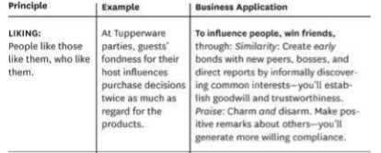
THE ART (AND SCIENCE) OF PERSUASION
Liking – We say ‘yes’ to people we like. The more we like them, the more we want to say ‘yes.’

Slide 4
LIKEABILITY
similarity of opinion, life-style, background, personality traits
familiarity and contact
cooperation in shared goals
similarity
praise.
Similarity literally draws people together.
Managers can use similarities to create bonds with a recent hire,
the head of another department, or even a new boss. Informal
conversations during the workday create an ideal opportunity to
discover at least one common area of enjoyment, be it a
hobby, a college basketball team.

Slide 5
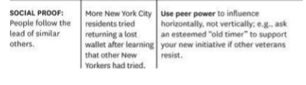
THE ART (AND SCIENCE) OF PERSUASION
Liking – We say ‘yes’ to people we like. The more we like them, the more we want to say ‘yes.’
Social Proof – We look to what others do to guide our behavior

Slide 6
SOCIAL PROOF
People follow the lead of similar others.
The application
Use peer power whenever it’s available.
A group of researchers went door-to-door in Columbia, South Carolina, soliciting donations for a charity campaign and displaying a list of neighborhood residents who had already donated to the cause. The researchers found that the longer the donor list was, the more likely those solicited would be to donate as well.

Slide 7
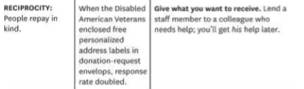
THE ART (AND SCIENCE) OF PERSUASION
Liking – We say ‘yes’ to people we like. The more we like them, the more we want to say ‘yes.’
Social Proof – We look to what others do to guide our behavior
Reciprocity – We feel obligated to return favors performed for us
Notes:
We’ve done Liking and Social proof. Let’s move on to Reciprocity
Simply: We feel obligated to return favors performed for us.
Lets jump right into the science.

Slide 8
CONTINUE…
People repay in kind.
The application
Give what you want to receive.
Praise is likely to have a warming and softening effect on Dan because, ornery as he is, still human and subject to the universal human tendency to treat people the way they treat him. If you have ever caught yourself smiling at a coworker just because he or she smiled first, you know how this principle works.
Charities rely on reciprocity to help them raise funds. For years, for instance, the Disabled American Veterans organization, using only a well-crafted fund-raising letter, garnered a very respectable 18% rate of response to its appeals. But when the group started enclosing a small gift in the envelope, the response rate nearly doubled to 35%. The gift—personalized address labels—was extremely modest, but it wasn’t what prospective donors received that made the difference. It was that they had gotten anything at all.

Slide 9
THE ART (AND SCIENCE) OF PERSUASION
Liking – We say ‘yes’ to people we like. The more we like them, the more we want to say ‘yes.’
Social Proof – We look to what others do to guide our behavior
Reciprocity – We feel obligated to return favors performed for us
Commitment and Consistency – We want to act consistently with our stated commitments and values
Notes:
We’ve done Liking, Social Proof and Reciprocity
Commitment and Consistency. My FAVORITE ONE. One of the most powerful for fundraising.

Slide 10
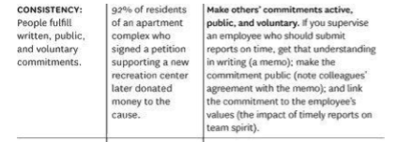
CONSISTENCY

Slide 11
COMMITMENT AND CONSISTENCY
People align with their clear commitments.
The application
Make their commitments active, public, and voluntary.
Israeli researchers writing in 1983 in the Personality and Social Psychology Bulletin recounted how they asked half the residents of a large apartment complex to sign a petition favoring the establishment of a recreation center for the handicapped. The cause was good and the request was small, so almost everyone who was asked agreed to sign.
Two weeks later, on National Collection Day for the Handicapped, all residents of the complex were approached at home and asked to give to the cause. A little more than half of those who were not asked to sign the petition made a contribution. But an astounding 92% of those who did sign donated money. The residents of the apartment complex felt obligated to live up to their commitments because those commitments were active, public, and voluntary.

Slide 12
THE ART (AND SCIENCE) OF PERSUASION
Liking – We say ‘yes’ to people we like. The more we like them, the more we want to say ‘yes.’
Social Proof – We look to what others do to guide our behavior
Reciprocity – We feel obligated to return favors performed for us
Commitment and Consistency – We want to act consistently with our stated commitments and values
Authority – We look for experts to show us the way
Notes:
I’m going to go over Authority VERY BRIEFLY since I think the other principles carry more weight, but this is a good one to keep in the back of our minds.

Slide 13
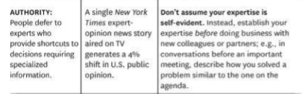
AUTHORITY
People defer to experts.
Expose your expertise; don’t assume it’s self-evident.

Slide 14
EXAMPLE
The physical therapy staffers were frustrated because so many of their stroke patients abandoned their exercise routines as soon as they left the hospital. No matter how often the staff emphasized the importance of regular home exercise. Interviews with some of the patients helped us pinpoint the problem. They were familiar with the background and training of their physicians, but the patients knew little about the credentials of the physical therapists who were urging them to exercise. It was a simple matter to remedy that lack of information: We merely asked the therapy director to display all the awards, diplomas, and certifications of her staff on the walls of the therapy rooms.
The result was startling: Exercise compliance jumped 34% and has never dropped since.

Slide 15
THE ART (AND SCIENCE) OF PERSUASION
Liking – We say ‘yes’ to people we like. The more we like them, the more we want to say ‘yes.’
Social Proof – We look to what others do to guide our behavior
Reciprocity – We feel obligated to return favors performed for us
Commitment and Consistency – We want to act consistently with our stated commitments and values
Authority – We look for experts to show us the way
Scarcity – The less available the resource, the more we want it.

Slide 16
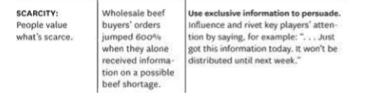
SCARCITY

Slide 17
SCARCITY
People want more of what they can have less of.
The application
Highlight unique benefits and exclusive information.
Study after study shows that items and opportunities are seen to be more valuable as they become less available.
That’s a tremendously useful piece of information for managers. They can harness the scarcity principle with the organizational equivalents of limited-time, limited-supply, and one-of-a-kind offers. Honestly informing a coworker of a closing window of opportunity— the chance to get the boss’s ear before she leaves for an extended vacation, perhaps—can mobilize action dramatically.

Slide 18
SCARCITY
People want more of what they can have less of.
The application
Highlight unique benefits and exclusive information.
Study after study shows that items and opportunities are seen to be more valuable as they become less available.
That’s a tremendously useful piece of information for managers. They can harness the scarcity principle with the organizational equivalents of limited-time, limited-supply, and one-of-a-kind offers. Honestly informing a coworker of a closing window of opportunity— the chance to get the boss’s ear before she leaves for an extended vacation, perhaps—can mobilize action dramatically.

Slide 19
EXAMPLE
A doctoral student, Amram Knishinsky, wrote his 1982 dissertation on the purchase decisions of wholesale beef buyers. He observed that they more than doubled their orders when they were told that, because of certain weather conditions overseas, there was likely to be a scarcity of foreign beef in the near future.
But their orders increased 600% when they were informed that no one else had that information yet.
The persuasive power of exclusivity can be harnessed by any manager who comes into possession of information that’s not broadly available and that supports an idea or initiative he or she would like the organization to adopt.

Slide 20
